Slide 1

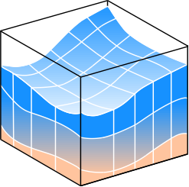

Development of a Boat Traffic Prediction Model Using an Artificial Neural Network
William Rossell
Advisors: Hakan Yasarer and Yavuz Ozeren

Slide 2
Preliminary Information for Model Development

Slide 3

Introduction
A major component of riverbank erosion is wave action, which in most cases are due to wind or boat traffic.
Despite the impact of boat-generated waves to the bank erosion, the availability of historic boat generated wave (BGW) data for study is extremely limited relative to data regarding wind generated waves.
BGW created by high-speed vessels are capable of producing wave heights sufficiently high enough to cause significant damage to the riverbanks.
The energy transmitted to the banks from BGW can be up to 60% of energy of the streamflow.

Slide 4
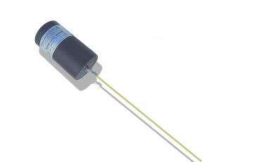
Data Acquisition
Information on Water Depth, River Stage, and Temperature was acquired using the OceanSensor Wave Staff mentioned in the previous presentation.
Precipitation Data was taken from the National Oceanic and Atmospheric Administration website, originally measured at a local weather station near Amherst, MA.

Slide 5
Inputs
Outputs
Month (C)
Day of the Month (C)
Day of the Week (C)
Holiday (C)
Type of Weather (C)
Amount of Precipitation
Ambient Outdoor Temperature
Water Depth
River Stage
Location (C)
Daily Boat Traffic

Slide 6
Any Questions?

Slide 7
Model Statistics and Comparisons

Slide 8
5 datasets were structured using different combinations of the various available inputs.
Each dataset was processed through feed-forward artificial neural networks (ANN) with varying number of hidden nodes ranging from a baseline up to as many as 15.
The baseline amount of hidden nodes ranged from 5 to 15.
For preliminary training and testing, all networks were run through 20,000 iterations, and certain normalized error quantities and the coefficient of determination (R²) were recorded at each 100-iteration mark for comparison.
Based on these comparisons, the three best performing network-iteration combinations were chosen for validation checks and all data training.

Slide 9
16 Input Model Considerations: Weekday, Holiday, Numerical Data, Location
 |  | 6-15-20000 | 5-15-20000 | 8-12-19900
TR | MARE | 31.833 | 30.555 | 32.05
 | R2 | 0.87513 | 0.87464 | 0.87127
 | ASE | 0.009466 | 0.009673 | 0.009818
TS | MARE | 31.639 | 29.828 | 31.713
 | R2 | 0.87272 | 0.87323 | 0.8688
 | ASE | 0.009615 | 0.009765 | 0.009976
VAL | MARE | 31.884 | 30.408 | 31.932
 | R2 | 0.86967 | 0.87372 | 0.86465
 | ASE | 0.009849 | 0.009783 | 0.010308
ALL | MARE | 28.729 | 31.772 | 30.407
 | R2 | 0.88666 | 0.85759 | 0.87668
 | ASE | 0.008826 | 0.011864 | 0.010162
FINAL BUILD | 6-15-20000
FINAL STRUCTURE | 16-15-1

Slide 10
19 Input Model Considerations: 16 Input Model + Categorical Weather
 |  | 11-15-20000 | 10-15-20000 | 7-15-20000
TR | MARE | 21.507 | 20.988 | 22
 | R2 | 0.93448 | 0.93426 | 0.93264
 | ASE | 0.004716 | 0.00475 | 0.004861
TS | MARE | 21.133 | 20.353 | 21.525
 | R2 | 0.93359 | 0.93383 | 0.93183
 | ASE | 0.004771 | 0.004778 | 0.004913
VAL | MARE | 21.294 | 20.76 | 21.96
 | R2 | 0.93209 | 0.93251 | 0.93073
 | ASE | 0.004894 | 0.004882 | 0.005004
ALL | MARE | 21.217 | 21.416 | 21.971
 | R2 | 0.93446 | 0.93511 | 0.93303
 | ASE | 0.004706 | 0.004675 | 0.00483
FINAL BUILD | 10-15-20000
FINAL STRUCTURE | 19-15-1

Slide 11
21 Input Model Considerations: 16 Input Model + Month
 |  | 8-15-20000 | 12-15-20000 | 9-15-20000
TR | MARE | 18.547 | 17.314 | 18.201
 | R2 | 0.96061 | 0.95587 | 0.95766
 | ASE | 0.003169 | 0.00325 | 0.003278
TS | MARE | 18.012 | 17.047 | 17.797
 | R2 | 0.96049 | 0.95585 | 0.95784
 | ASE | 0.003171 | 0.003241 | 0.003256
VAL | MARE | 18.161 | 17.266 | 17.792
 | R2 | 0.96092 | 0.9566 | 0.95838
 | ASE | 0.003157 | 0.003201 | 0.003232
ALL | MARE | 17.301 | 18.016 | 16.49
 | R2 | 0.9709 | 0.96175 | 0.97192
 | ASE | 0.002142 | 0.002975 | 0.002086
FINAL BUILD | 9-15-20000
FINAL STRUCTURE | 21-15-1

Slide 12
24 Input Model Considerations: 16 Input Model + Categorical Weather, Month
 |  | 5-15-20000 | 6-15-20000 | 9-15-20000
TR | MARE | 14.18 | 12.466 | 12.778
 | R2 | 0.98093 | 0.98076 | 0.97995
 | ASE | 0.001372 | 0.001388 | 0.001445
TS | MARE | 13.455 | 12.106 | 12.131
 | R2 | 0.98092 | 0.98076 | 0.98002
 | ASE | 0.00137 | 0.001386 | 0.001438
VAL | MARE | 13.763 | 12.581 | 12.335
 | R2 | 0.98012 | 0.97987 | 0.97927
 | ASE | 0.001432 | 0.001452 | 0.001494
ALL | MARE | 12.452 | 12.775 | 12.129
 | R2 | 0.98207 | 0.98221 | 0.98262
 | ASE | 0.001322 | 0.001383 | 0.001353
FINAL BUILD | 9-15-20000
FINAL STRUCTURE | 24-15-1

Slide 13
55 Input Model Considerations: 24 Input Model + Day of the Month
 |  | 10-15-20000 | 11-15-19300 | 12-15-19800
TR | MARE | 0.475 | 0.507 | 0.497
 | R2 | 1 | 1 | 1
 | ASE | 0 | 0 | 0
TS | MARE | 0.347 | 0.444 | 0.466
 | R2 | 1 | 1 | 0.99999
 | ASE | 0 | 0 | 0
VAL | MARE | 0.533 | 0.548 | 0.497
 | R2 | 0.99999 | 0.99999 | 0.99999
 | ASE | 0.000001 | 0.000001 | 0
ALL | MARE | 0.384 | 0.297 | 0.276
 | R2 | 1 | 1 | 1
 | ASE | 0 | 0 | 0
FINAL BUILD | 12-15-19800
FINAL STRUCTURE | 55-15-1

Slide 15
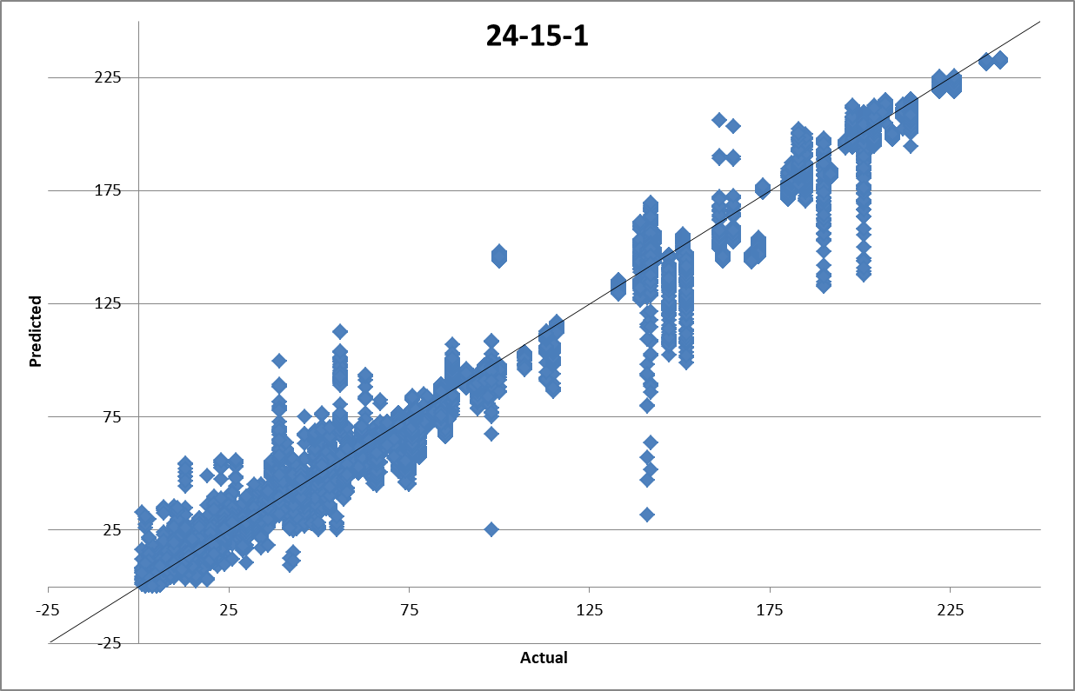
Statistics
MARE | 12.343
R² | 0.9826
ASE | 95.389
RMS | 9.767
MAE | 6.504
Tolerance | % Success
Absolute (±0) | 5.97
± 5 | 51.64
± 10 | 79.94

Slide 16
Questions?

